Slide 1
Notice
Homework (Deadline:10/30 9:00) p.60
Run on a physical device p.53
If you use Windows OS, you need install the USB Driver (p.53)

Slide 2
Android
Android Developer Fundamentals
Lesson 1

Slide 3
1.0 Introduction to Android

Slide 4
Contents
Android is an ecosystem
Android platform architecture
Android Versions
Challenges of Android app development
App fundamentals

Slide 5
Android Ecosystem

Slide 6
What is Android?
Mobile operating system based on Linux kernel
User Interface for touch screens
Used on over 80% of all smartphones
Powers devices such as watches, TVs, and cars
Over 2 Million Android apps in Google Play store
Highly customizable for devices / by vendors
Open source
Notes:
Pass

Slide 7
Android user interaction
Touch gestures: swiping, tapping, pinching
Virtual keyboard for characters, numbers, and emoji
Support for Bluetooth, USB controllers and peripherals
Notes:
Pass

Slide 8
Android and sensors
Sensors can discover user action and respond
Device contents rotate as needed
Walking adjusts position on map
Tilting steers a virtual car or controls a physical toy
Moving too fast disables game interactions
Notes:
Pass

Slide 9
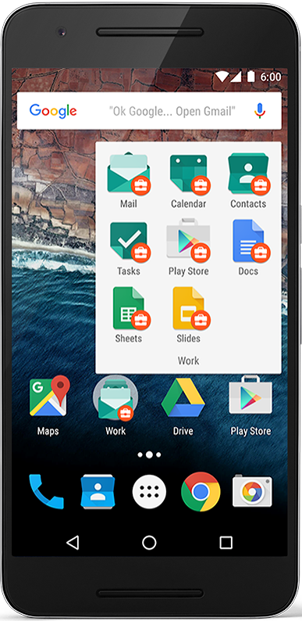
Android home screen
Launcher icons for apps
Self-updating widgets for live content
Can be multiple pages
Folders to organize apps
"OK Google"
Notes:
Pass

Slide 10
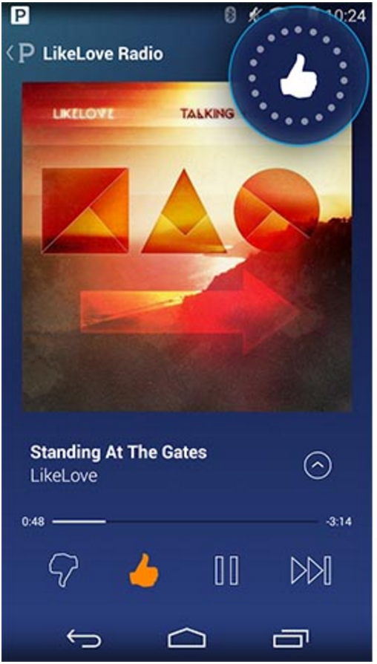
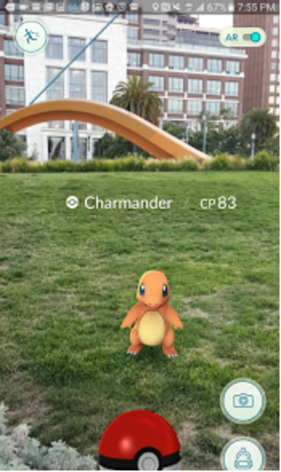
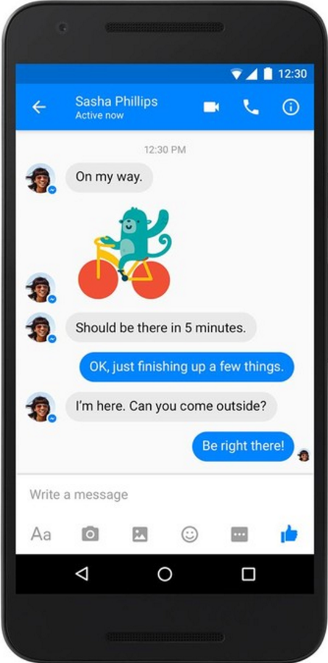
Android app examples
Pandora
Pokemon GO
Facebook Messenger
Notes:
Pass

Slide 11
Android Software Developer Kit (SDK)
Development tools (debugger, monitors, editors)
Libraries (maps, wearables)
Virtual devices (emulators)
Documentation (developers.android.com)
Sample code

Slide 12
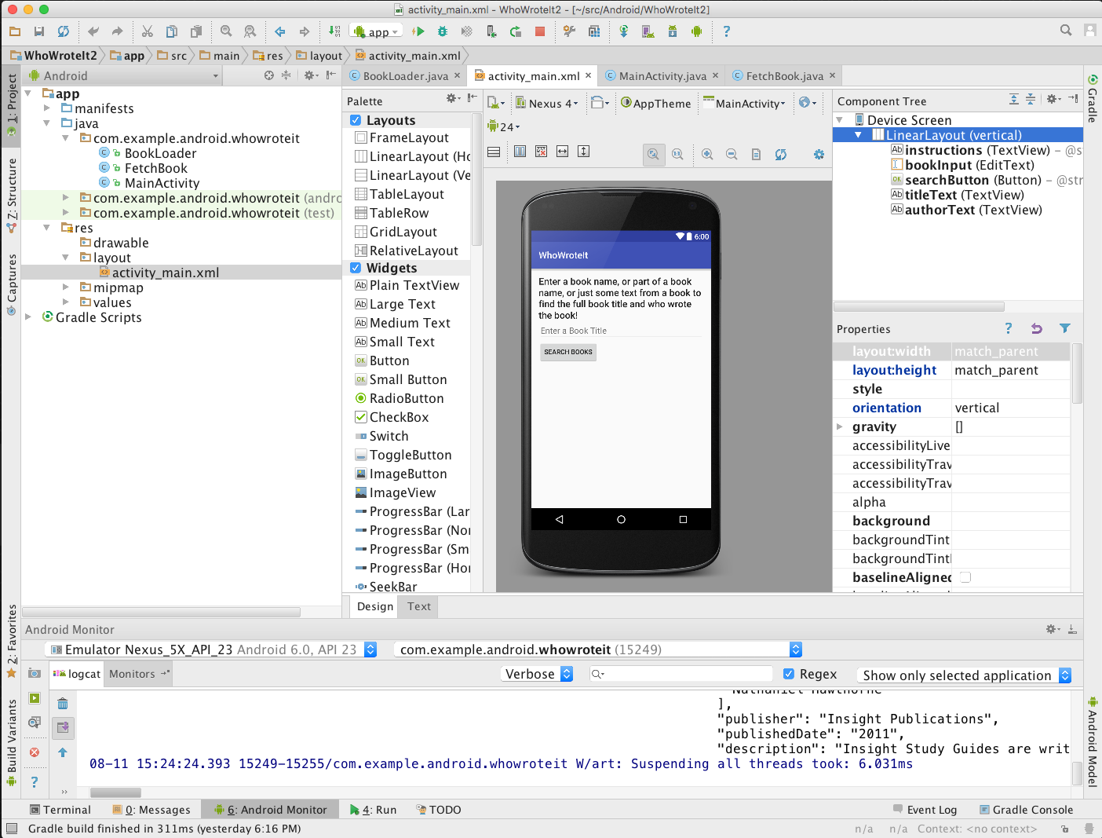
Android Studio
Official Android IDE
Develop, run, debug, test, and package apps
Monitors and performance tools
Virtual devices
Project views
Visual layout editor

Slide 13
Google Play store
Publish apps through Google Play store:
Official app store for Android
Digital distribution service operated by Google

Slide 14
Android Platform Architecture
This work is licensed under a Creative Commons Attribution-NonCommercial 4.0 International License

Slide 15
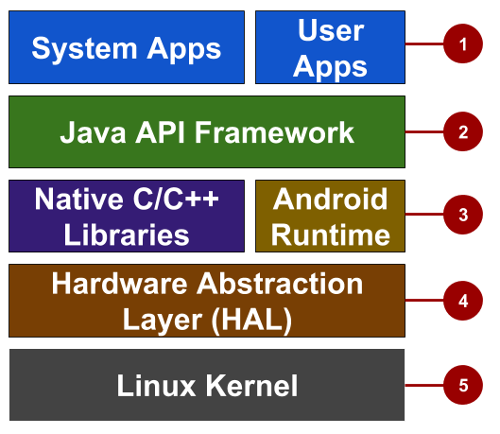
Android stack
System and user apps
Android OS API in Java framework
Expose native APIs; run apps
Expose device hardware capabilities
Linux Kernel

Slide 16
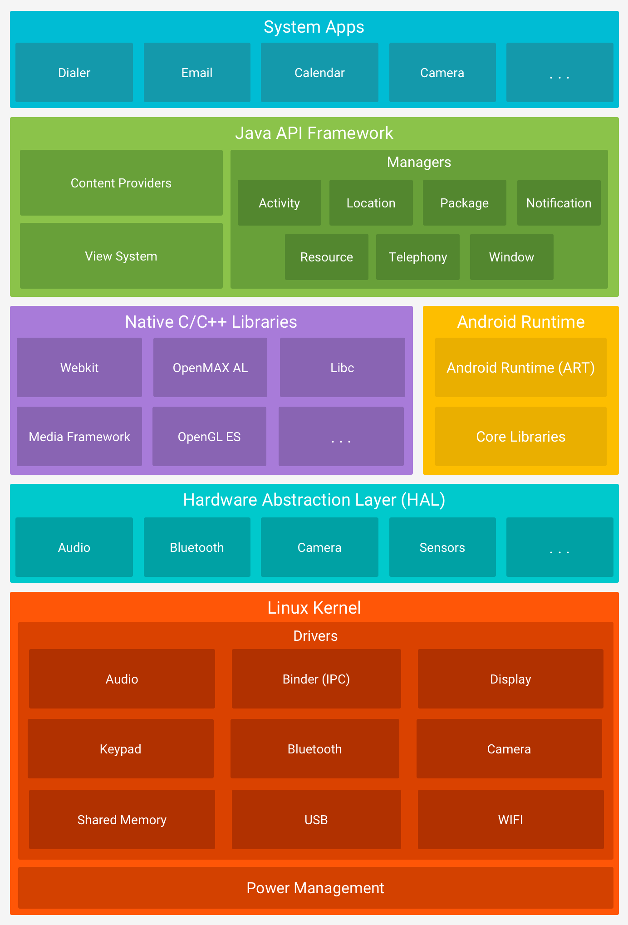
Android software stack
https://developer.android.com/guide/platform/

Slide 17
System and user apps
System apps have no special status
System apps provide key capabilities to app developers
Example:
Your app can use a system app to deliver a SMS message.

Slide 18
Java API Framework
The entire feature-set of the Android OS is available to you through APIs written in the Java language.
View class hierarchy to create UI screens
Notification manager
Activity manager for life cycles and navigation
Content providers to access data from other apps

Slide 19
Android runtime
Each app runs in its own process with its own instance of the Android Runtime.

Slide 20
C/C++ libraries
Core C/C++ Libraries give access to core native Android system components and services.

Slide 21
Hardware Abstraction Layer (HAL)
Standard interfaces that expose device hardware capabilities as libraries Examples: Camera, bluetooth module

Slide 22
Linux Kernel
Threading and low-level memory management
Security features
Drivers

Slide 23
Android versions
Codename | Version | Released | API Level
Honeycomb | 3.0 - 3.2.6 | Feb 2011 | 11 - 13
Ice Cream Sandwich | 4.0 - 4.0.4 | Oct 2011 | 14 - 15
Jelly Bean | 4.1 - 4.3.1 | July 2012 | 16 - 18
KitKat | 4.4 - 4.4.4 | Oct 2013 | 19 - 20
Lollipop | 5.0 - 5.1.1 | Nov 2014 | 21 - 22
Marshmallow | 6.0 - 6.0.1 | Oct 2015 | 23
Nougat | 7.0 - 7.1.2 | Aug 2016 | 24 - 25
Oreo | 8.0 – 8.1 | Aug 2017 | 26 - 27
Pie | 9.0 | Aug 2018 | 28
Android History and Platform Versions
for more and earlier versions before 2011

Slide 24
App Development
This work is licensed under a Creative Commons Attribution-NonCommercial 4.0 International License

Slide 25
What is an Android app?
One or more interactive screens
Written using Java Programming Language and XML
Uses the Android Software Development Kit (SDK)
Uses Android libraries and Android Application Framework
Executed by Android Runtime Virtual machine (ART)

Slide 26
Challenges of Android development
Multiple screen sizes and resolutions
Performance: make your apps responsive and smooth
Security: keep source code and user data safe
Compatibility: run well on older platform versions
Marketing: understand the market and your users (Hint: It doesn't have to be expensive, but it can be.)
Notes:
Compatibility兼容性

Slide 27
App building blocks
Resources: layouts, images, strings, colors as XML and media files
Components: activities, services, …, and helper classes as Java code
Manifest: information about app for the runtime
Build configuration: APK versions in Gradle config files

Slide 28
Component types
Activity is a single screen with a user interface
Service performs long-running tasks in background
Content provider manages shared set of data
Broadcast receiver responds to system-wide announcements

Slide 29
Think of Android as a hotel
Your app is the guest
The Android System is the hotel manager
Services are available when you request them (intents)
In the foreground (activities) such as registration
In the background (services) such as laundry
Calls you when a package has arrived (broadcast receiver)
Access the city's tour companies (content provider)

Slide 30
Learn more
Android History
Introduction to Android
Platform Architecture
UI Overview
Platform Versions
Supporting Different Platform Versions
Android Studio User’s Guide

Slide 31
What's Next?
Concept Chapter: 1.0 C Introduction to Android
Practical: –

Slide 32
END

Slide 33
Hello World
Android Developer Fundamentals
Lesson 1
This work is licensed under a Creative Commons Attribution-NonCommercial 4.0 International License

Slide 34
1.1 Create Your First Android App
This work is licensed under a Creative Commons Attribution-NonCommercial 4.0 International License

Slide 35
Contents
Android Studio
Creating "Hello World" app in Android Studio
Basic app development workflow with Android Studio
Running apps on virtual and physical devices

Slide 36
Prerequisites
Java Programming Language
Object-oriented programming
XML - properties / attributes
Using an IDE for development and debugging

Slide 37
Android Studio
This work is licensed under a Creative Commons Attribution-NonCommercial 4.0 International License

Slide 38
What is Android Studio?
Android IDE
Project structure
Templates
Layout Editor
Testing tools
Gradle-based build
Log Console
Debugger
Monitors
Emulators

Slide 39
Installation Overview
Mac, Windows, or Linux
Requires Java Development Kit (JDK) 1.7 or better from Oracle Java SE downloads page
Set JAVA_HOME to JDK installation location
Download and install Android Studio from http://developer.android.com/sdk/index.html
See 1.1 P Install Android Studio for details

Slide 40
Creating Your First Android App
This work is licensed under a Creative Commons Attribution-NonCommercial 4.0 International License

Slide 41
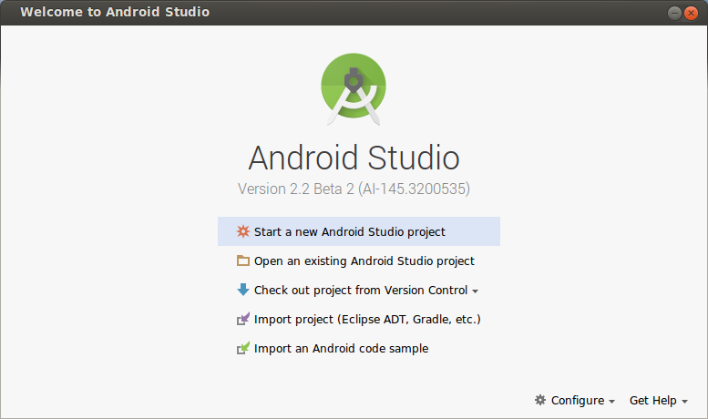
Start Android Studio

Slide 42
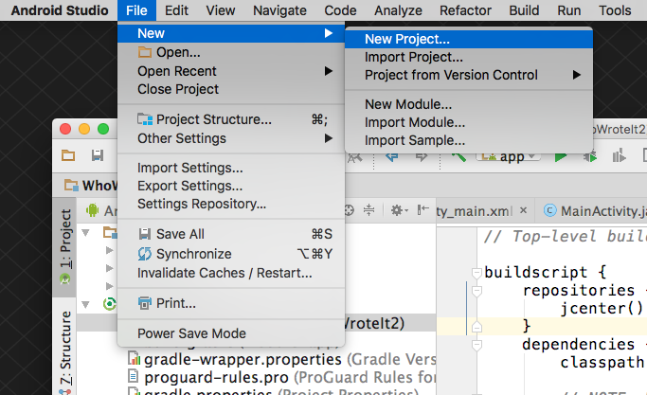
Create a project inside Android Studio

Slide 43
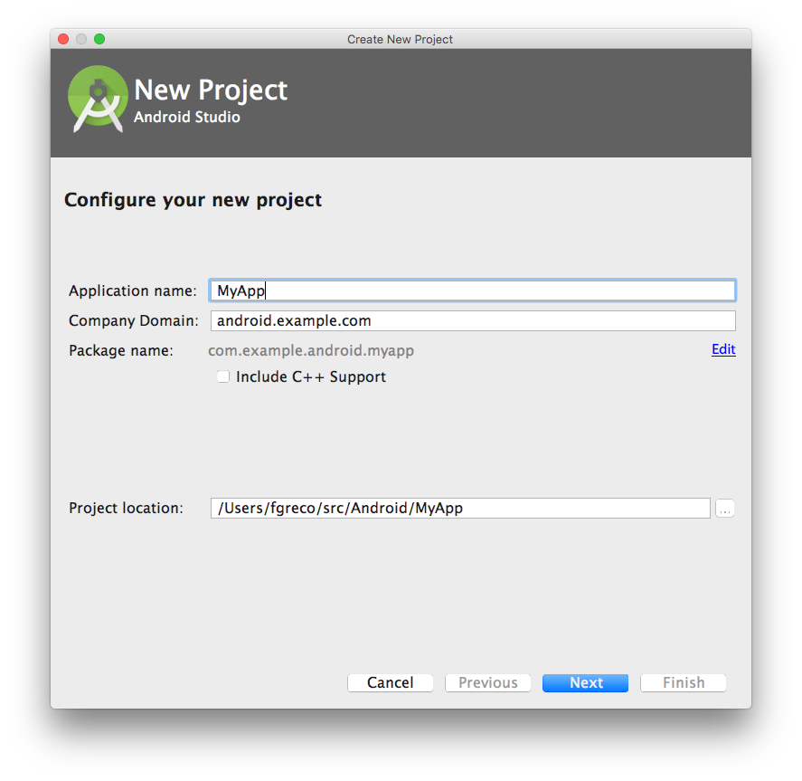
Name your app

Slide 44
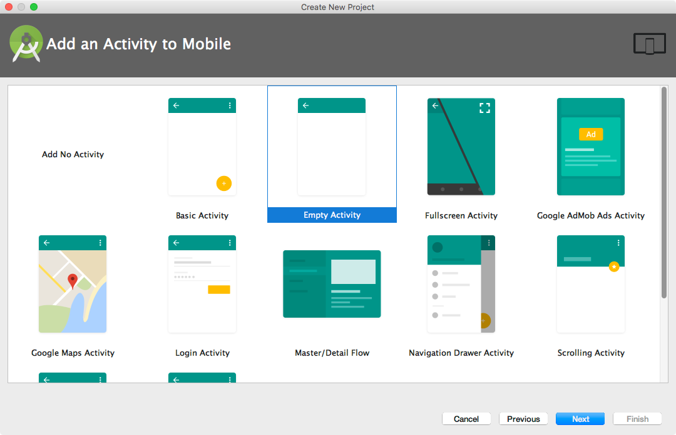
Pick activity template
Choose templates for common activities, such as maps or navigation drawers.
Pick Empty Activity or Basic Activity for simple and custom activities.

Slide 45
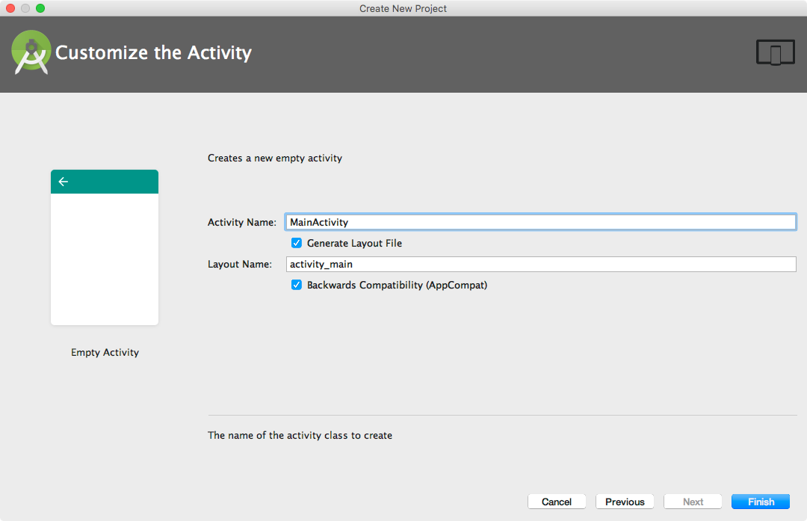
Name your activity
Good practice to name main activity MainActivity and activity_main layout
Use AppCompat
Generating layout file is convenient

Slide 46
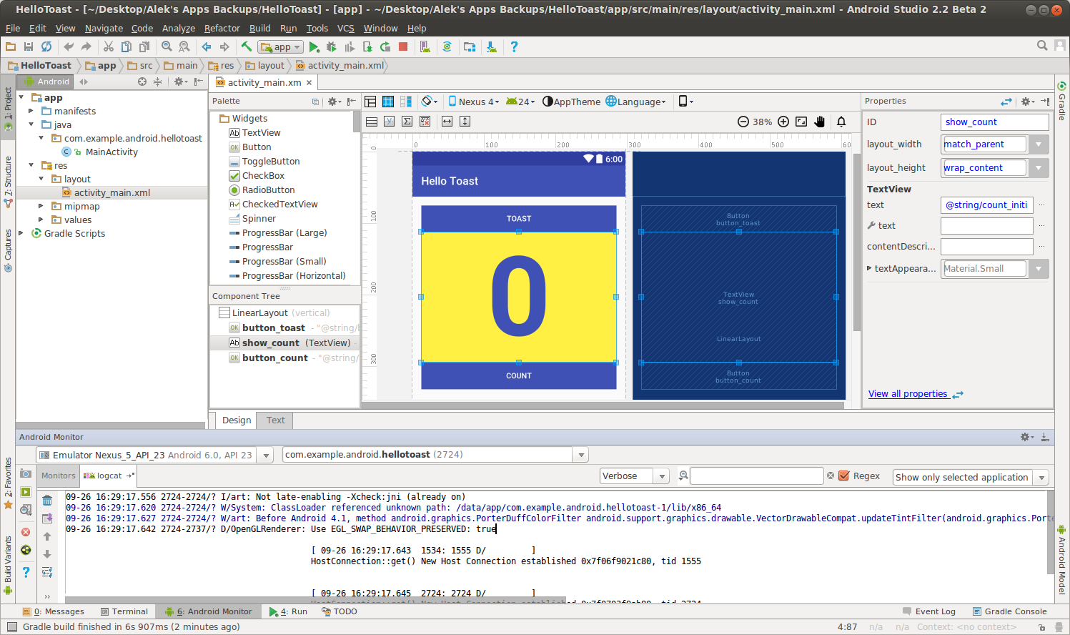
Android Studio Panes
Layout Editor
Project
Files
Android Monitors:
logcat: log messages

Slide 47
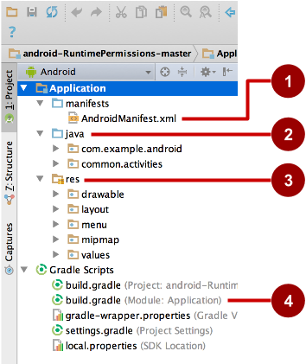
Project folders
manifests—Android Manifest file - description of app read by the Android runtime
java—Java source code packages
res—Resources (XML) - layout, strings, images, dimensions, colors...
build.gradle—Gradle build files

Slide 48
Gradle build system
Modern build subsystem in Android Studio
Three build.gradle:
project
module
settings
Typically not necessary to know low-level Gradle details
Learn more about gradle at https://gradle.org/

Slide 49
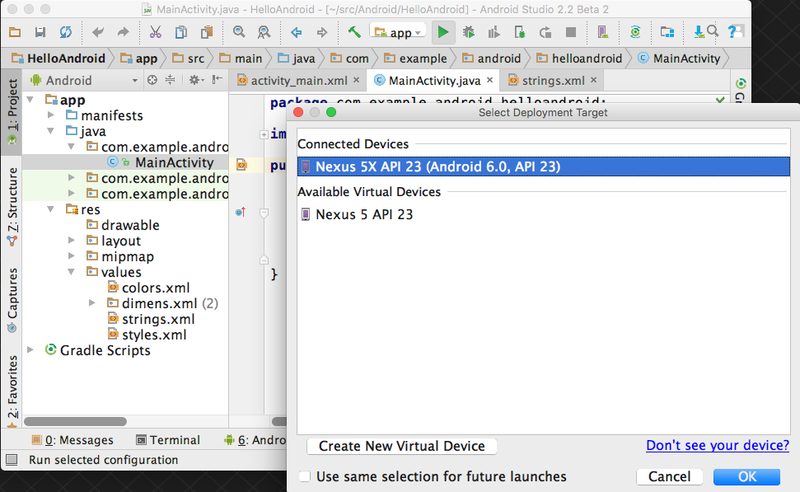
Run your app
Run
2. Select virtual or physical device
3. OK

Slide 50
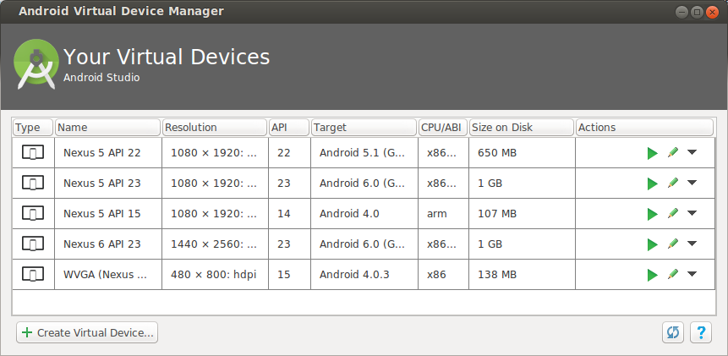
Create a virtual device
Use emulators to test app on different versions of Android and form factors.
Tools > Android > AVD Manager or:

Slide 51
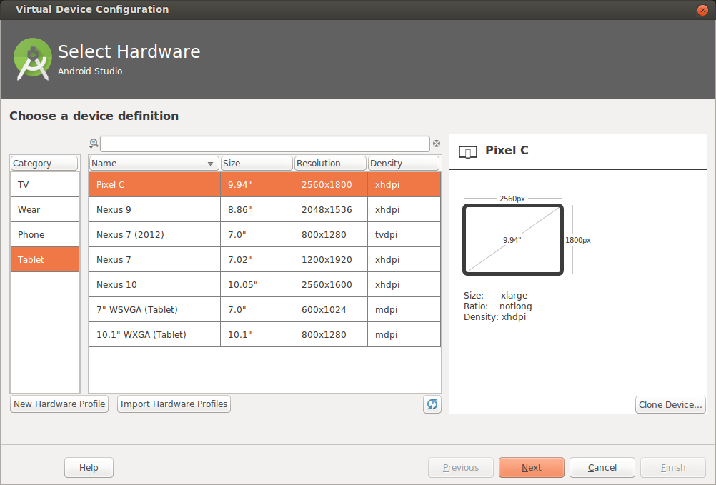
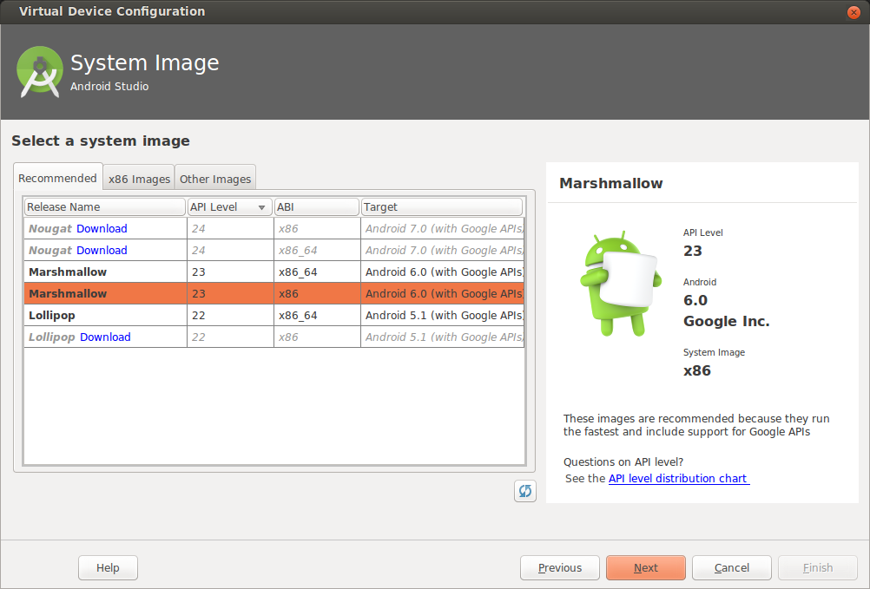
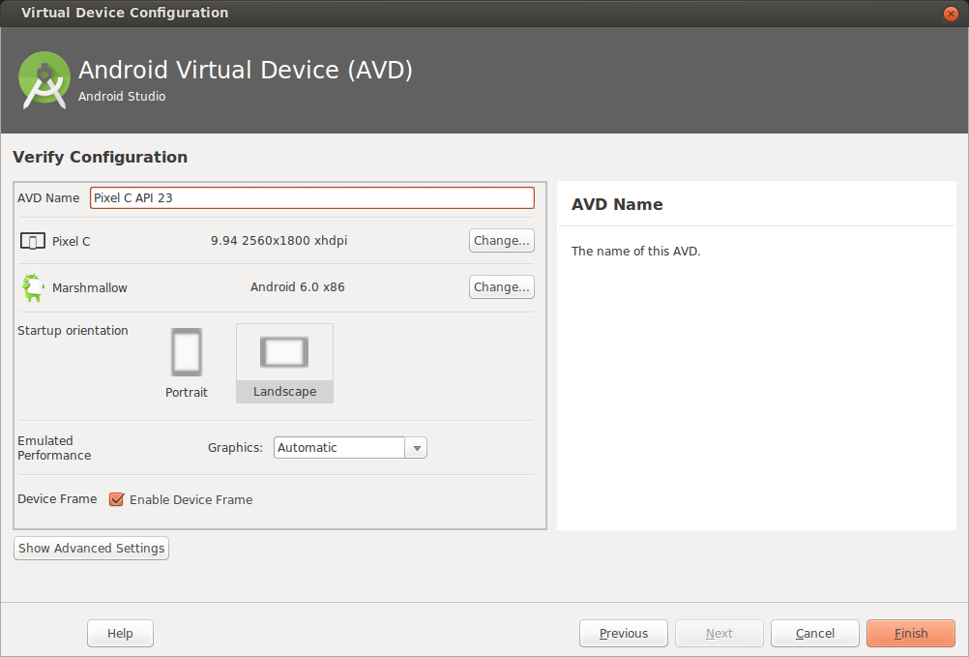
Configure virtual device
Choose hardware
2. Select Android Version
3. Finalize

Slide 52
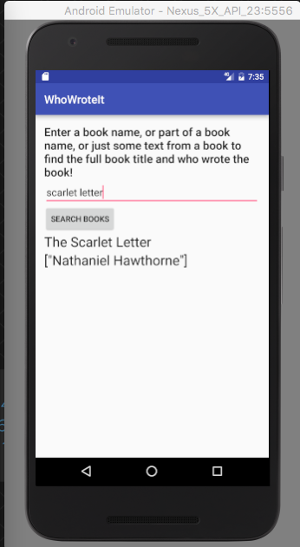
Run on a virtual device

Slide 53
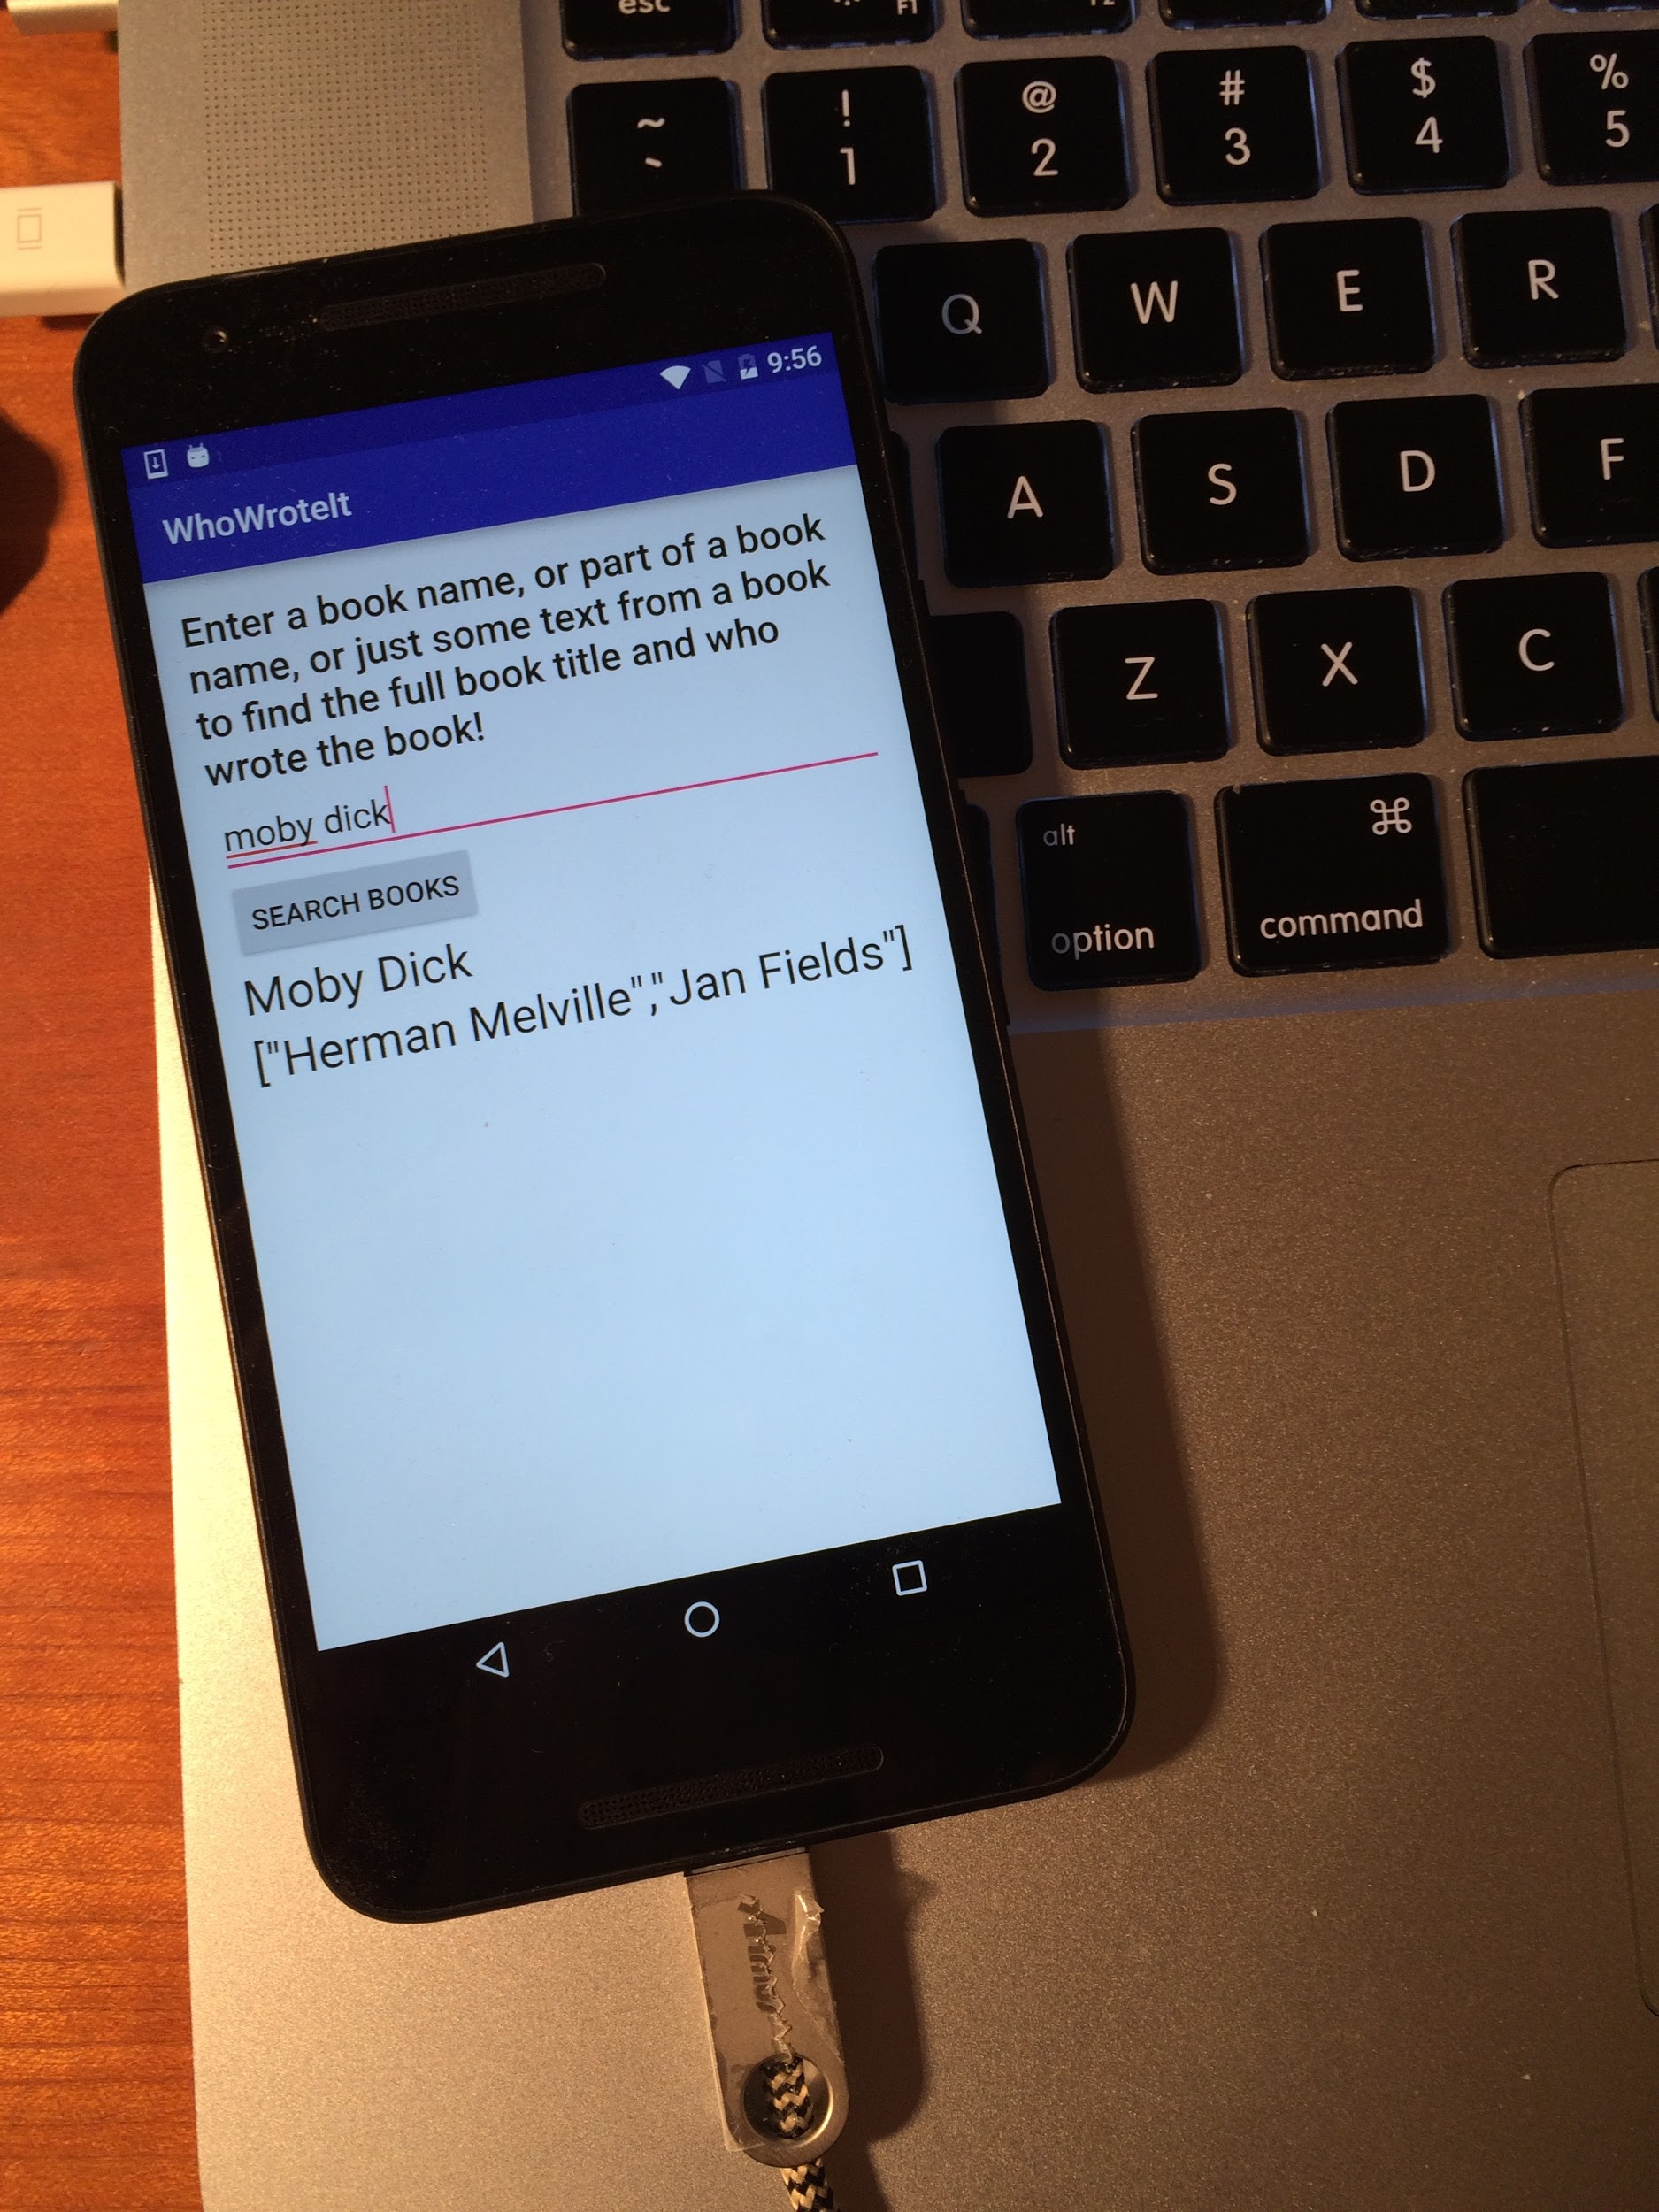
Run on a physical device
Turn on Developer Options:
Settings > About phone
Tap Build number seven times
Turn on USB Debugging
Settings > Developer Options > USB Debugging
Connect phone to computer with cable
Windows/Linux additional setup:
Using Hardware Devices (https://developer.android.com/studio/run/device)
Windows drivers:
OEM USB Drivers (https://developer.android.com/studio/run/oem-usb)

Slide 54
Get feedback as your app runs
As the app runs, Android Monitor logcat shows information
You can add logging statements to your app that will show up in logcat.

Slide 55
Logging
import android.util.Log;
// Use class name as tag
private static final String TAG = MainActivity.class.getSimpleName();
// Show message in Android Monitor, logcat pane
// Log.<log-level>(TAG, "Message");
Log.d(TAG, “Creating the URI…”);

Slide 56
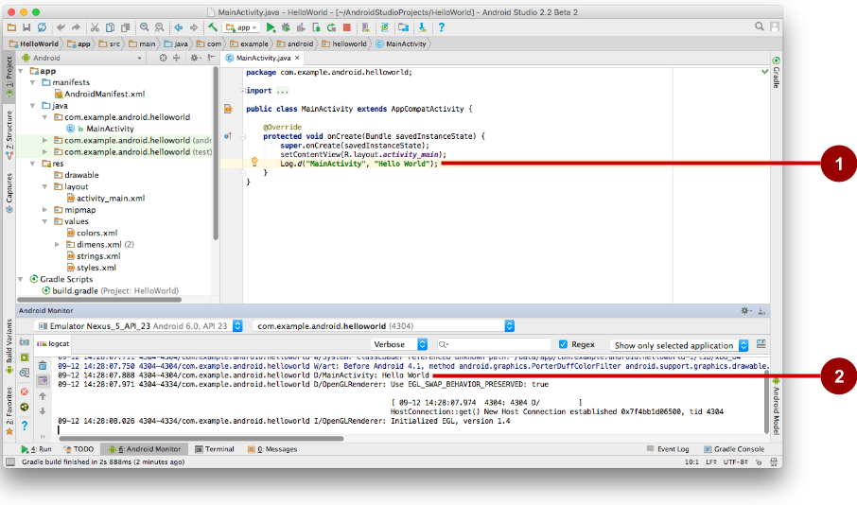
Android Monitor > logcat pane
Log statements in code.
logcat pane shows system and logging messages
Set filters to see what's important to you
Search using tags

Slide 57
Learn more
Meet Android Studio
Official Android documentation at developer.android.com
Create and Manage Virtual Devices
Supporting Different Platform Versions
Supporting Multiple Screens

Slide 58
Learn even more
Gradle Wikipedia page
Google Java Programming Language style guide
Find answers at Stackoverflow.com

Slide 59
What's Next?
Concept Chapter: 1.1 C Create Your First Android App
Practical: 1.1 P Install Android Studio and Run Hello World

Slide 60
Homework (Deadline:10/30 9:00)
Install Android Studio
Create a project (Set Application Name as your id and name)
Create a virtual device
Run the app at the virtual device and take a screenshot.
Please send the screenshot to wmshw@wmlab.csie.ncu.edu.tw
(Title:WMS_Experiment 1_ID_YOURNAME)

Slide 61
END

